Slide 1
Chapter 3: Understanding Your Software's Bias and Accuracy Measures
M. Hichame Benbitour
CentraleSupélec, France
22/09/2020

Slide 2
Outline
Bias and accuracy
Fitting and forecasting
Evaluations
Bias measures
Accuracy measures
Exception reporting
Forecast value-added analysis (FVA)
Conclusions

Slide 3
Bias and accuracy

Slide 4
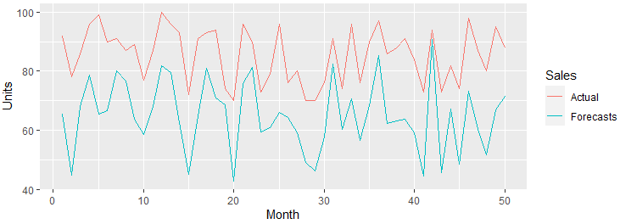
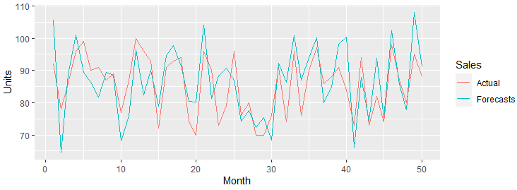
Bias
Bias in forecasts refers to a persistent tendency for the forecasts to be too high or too low.
Too low forecasts
Unbiased forecasts

Slide 5
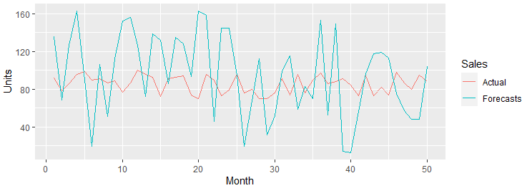
Accuracy
Accuracy measures represent the typical closeness of the forecast to the actual sales.
Inaccurate forecasts
Accurate forecasts

Slide 6
Forecasts, actual sales and noise
It's important to remember that there is almost certain to be a difference between a forecast and actual sales because of noise.
Forecasting methods are not intended to anticipate noise.
Some sales histories consist largely of noise, so large differences are to be expected since the product's sales are largely unpredictable.

Slide 7
Fitting and forecasting

Slide 8
Fitting and forecasting
When measuring the accuracy of a forecasting method, it's important to distinguish between the “fit” of the method and its “true” forecasting accuracy.
The difference between the actual sales and the fitted value is called a residual.
To truly test a forecasting method, we should hide some of our sales data from it and see how well it forecasts sales that it hasn't seen.
To test a method, sales histories are therefore divided into fitting (or in-sample) periods, which enable the computer to decide what it thinks is the best method and model and hold-out (or out-of-sample) periods that allow us to see how well the chosen model forecasts sales it hasn't seen.

Slide 9
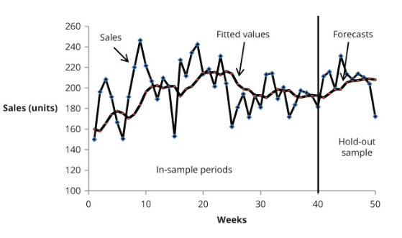
In-sample and out-of-sample periods
Fitting (in-sample) and hold-out periods

Slide 10
In-sample and out-of-sample periods
It's always possible to find a forecasting model that perfectly fits sales in the in-sample periods.
But when such a model is tested on the hold-out sample, it is likely to perform badly. This is called overfitting.
https://twitter.com/i/status/1123278396308353024

Slide 11
Evaluations
Fixed-Origin Evaluations
Rolling-Origin Evaluations

Slide 12
Fixed-Origin Evaluations
fixed-origin
All our forecasts originate from the information we have up to week 40. This is therefore called a fixed-origin evaluation.

Slide 13
Fixed-Origin Evaluations
Limitations
One forecast for each lead time
Second, some forecasting software products would report the average accuracy of our 10 out-of-sample forecasts. But the 10-period-ahead forecast is likely to be far less accurate than the one- or two-period-ahead forecasts.
If, by bad luck, there happened to be something unusual about the sales in week 40 (e.g., they were unusually high), then this might distort the subsequent forecasts and give us a misleading impression of their typical accuracy.
Solution: rolling-origin evaluation

Slide 14
Rolling-Origin Evaluations
Principle
Origin: week 40
Record the accuracy of forecasts for weeks 41 to 50
Move the origin to week 41
Record the accuracy of forecasts for weeks 42 to 50
….
Move the origin to week 49
Record the accuracy of forecast for week 50

Slide 15
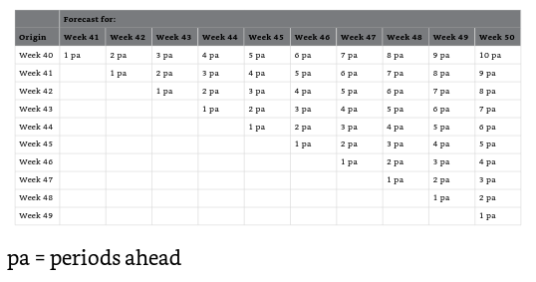
Rolling-Origin Evaluations
10 one-period-ahead forecasts
There is a single 10-period-ahead forecast, so the estimate of the likely accuracy of forecasts for this lead time would have to be treated with caution.

Slide 16
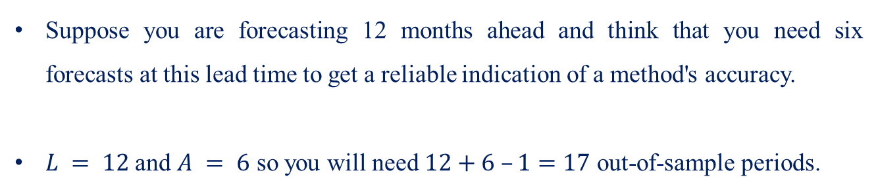
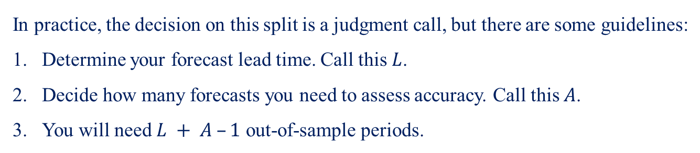
Guidelines to split sales history
In practice, the decision on this split is a judgment call, but there are some guidelines:
Determine your forecast lead time. Call this $L$.
Decide how many forecasts you need to assess accuracy. Call this $A$.
You will need $L + A –1$ out-of-sample periods.
Example
Suppose you are forecasting 12 months ahead and think that you need six forecasts at this lead time to get a reliable indication of a method's accuracy.
$L = 12$and $A = 6$ so you will need $12+6 –1=17$ out-of-sample periods.

Slide 17
Bias measures
The mean error (ME)
The Mean Percentage Error (MPE)

Slide 18
Forecast errors
Example: sales of a product over 15 weeks, and one-period-ahead forecasts
No. of Units Sold | Forecasts | Errors | Percentage Error
112 | 85 | 27 | 24,1%
109 | 88 | 21 | 19,3%
119 | 90 | 29 | 24,4%
138 | 93 | 45 | 32,6%
81 | 98 | -17 | -21,0%
128 | 96 | 32 | 25,0%
101 | 99 | 2 | 2,0%
115 | 99 | 16 | 13,9%
85 | 101 | -16 | -18,8%
113 | 99 | 14 | 12,4%
65 | 100 | -35 | -53,8%
68 | 97 | -29 | -42,6%
85 | 94 | -9 | -10,6%
122 | 93 | 29 | 23,8%
139 | 96 | 43 | 30,9%
Error = Actual sales – Forecast
A positive error indicates that the forecast was too low
A negative error indicates it was too high

Slide 19
Forecast errors
The mean error (ME) = sum of Errors / number of forecasts
=10.1 units
Errors | Percentage Error
27 | 24,1%
21 | 19,3%
29 | 24,4%
45 | 32,6%
-17 | -21,0%
32 | 25,0%
2 | 2,0%
16 | 13,9%
-16 | -18,8%
14 | 12,4%
-35 | -53,8%
-29 | -42,6%
-9 | -10,6%
29 | 23,8%
43 | 30,9%
ME is positive, it suggests that there is a tendency to underforecast sales.
If a method is unbiased, we would expect that, in the long run, the mean error will be zero.
The Mean Percentage Error (MPE) = 4.1 %
A percentage error is useful when we want an assessment of the seriousness of an error.
We need to be careful when using measures based on percentage errors if we occasionally get very low, or even zero, sales.

Slide 20
Accuracy measures
Direct accuracy measures
Percentage accuracy measures
Relative accuracy measures

Slide 21
Direct accuracy measures
The mean error cannot measure the accuracy of forecasts
Example: when two consecutive errors are +2,000 and -2,000, the mean error is zero, but forecasts are not accurate
Some measures
The Mean Absolute Error (MAE)=sum of the absolute errors / the number of forecasts
The Mean Squared Error (MSE)= sum of the squared errors / the number of forecasts
The root mean squared error (RMSE)= square root of MSE

Slide 22
Direct accuracy measures
Absolute Errors | Squared Errors
27 | 729
21 | 441
29 | 841
45 | 2025
17 | 289
32 | 1024
2 | 4
16 | 256
16 | 256
14 | 196
35 | 1225
29 | 841
9 | 81
29 | 841
43 | 1849
The Mean Absolute Error (MAE)= 24.3 units
The Mean Squared Error (MSE)= 726.5 squared units
The root mean squared error (RMSE)= 27.0 units

Slide 23
Percentage accuracy measures
Percentage accuracy measures are designed to reflect the seriousness of errors by expressing the typical error as a percentage of actual or typical sales.
Percentage accuracy measures also have the advantage that they do not depend on the volume of your sales (scale free)
You can compare the forecast accuracy of a method across different products whose sales volumes may vary considerably.
Some measures
The Mean Absolute Percentage Error (MAPE)
The Median Absolute Percentage Error (MDAPE)
The Symmetric Mean Absolute Percentage Error (SMAPE)
The MAD/MEAN Ratio

Slide 24
Percentage accuracy measures
The Mean Absolute Percentage Error (MAPE)
Errors | Percentage Error | Absolute Percentage Errors
27 | 24,1% | 24,1%
21 | 19,3% | 19,3%
29 | 24,4% | 24,4%
45 | 32,6% | 32,6%
-17 | -21,0% | 21,0%
32 | 25,0% | 25,0%
2 | 2,0% | 2,0%
16 | 13,9% | 13,9%
-16 | -18,8% | 18,8%
14 | 12,4% | 12,4%
-35 | -53,8% | 53,8%
-29 | -42,6% | 42,6%
-9 | -10,6% | 10,6%
29 | 23,8% | 23,8%
43 | 30,9% | 30,9%
MAPE= mean of absolute percentage errors
=23.7%
Care should be taken when some sales figures are small or zero.

Slide 25


Percentage accuracy measures
The Median Absolute Percentage Error (MDAPE)
Example
The computer will find the median by ordering the absolute percentage errors from smallest to largest and identifying the middle value.
The MDAPE is 5%. In contrast, the MAPE is 148%,
For the forecasts in the previous example the MDAPE is 23.8%, which is almost identical to the MAPE.

Slide 26
Percentage accuracy measures
The Symmetric Mean Absolute Percentage Error (SMAPE)
Absolute Errors | Average Forecast & Actual Sales | Symmetric Absolute % Errors
27 | 98,5 | 27,4%
21 | 98,5 | 21,3%
29 | 104,5 | 27,8%
45 | 115,5 | 39,0%
17 | 89,5 | 19,0%
32 | 112 | 28,6%
2 | 100 | 2,0%
16 | 107 | 15,0%
16 | 93 | 17,2%
14 | 106 | 13,2%
35 | 82,5 | 42,4%
29 | 82,5 | 35,2%
9 | 89,5 | 10,1%
29 | 107,5 | 27,0%
43 | 117,5 | 36,6%
First takes the average of the forecast and actual sales.
Then calculates the error as a percentage of this average: the symmetric absolute percentage error
The SMAPE is obtained by taking the mean of the column of symmetric absolute percentage errors.
SMAPE = 24,1%
SMAPE can be calculated where some of the actual sales are zero
It is not symmetric.

Slide 27
Percentage accuracy measures
When There Is a Trend or Seasonal Pattern
If there is an upward trend in your data, the increase in your actual sales will tend to make these percentage accuracy measures become smaller over time
The reverse is true for a downward trend.
If there is a seasonal pattern, with lower sales in the winter and higher in the summer, your winter sales forecasts will tend to look less accurate than those for the summer.

Slide 28
Relative accuracy measures
Relative accuracy measures are designed to allow us to compare the accuracy of a method we are considering using against the benchmark of a simple competitor.
Usually, this simple competitor is a naïve forecast – that is, a forecast that equals the most recent sales figure.
Relative accuracy measures are scale free.
Some measures
Geometric Mean Relative Absolute Error (GMRAE)
The Mean Absolute Scaled Error (MASE)
Bayesian Information Criterion (BIC), SBC, AIC

Slide 29

Relative accuracy measures
Geometric Mean Relative Absolute Error (GMRAE)
Example
Last week sales: 53 units
Naïve forecast of the next week: 53 units
Computer forecast: 70 units
Actual sales: 80 units
Absolute error of computer forecast: 10 units
The absolute error of naïve forecast: 27 units.
The ratio of the absolute errors of the two forecasts is called the relative absolute error (RAE) where:

Slide 30

Relative accuracy measures
RAE=10/27 = 0.37. This shows that the computer forecast error was less than half that of the naïve forecast
Calculate their geometric mean, the computer would first multiply the RAEs together to get 0.054. Then, because we have seven values, it would take their seventh root. This gives a GMRAE of 0.66
Advantage
it can be used where there is a trend or seasonal pattern
Inconvenient
GMRAE cannot generally be used where demand is intermittent

Slide 31
Relative accuracy measures
The Mean Absolute Scaled Error (MASE)
The MASE is found by dividing the MAE of our chosen forecasting method by the MAE of naïve forecasts.
No. of Units Sold | Naïve Forecasts | Naïve Forecast Absolute Errors
112
109 | 112 | 3
119 | 109 | 10
138 | 119 | 19
81 | 138 | 57
128 | 81 | 47
101 | 128 | 27
115 | 101 | 14
85 | 115 | 30
113 | 85 | 28
65 | 113 | 48
68 | 65 | 3
85 | 68 | 17
122 | 85 | 37
139 | 122 | 17
Our chosen method has an MAE of 24.1
Naïve forecasts have an MAE of 25.5
MASE is 24.1/25.5 = 0.94

Slide 32
Relative accuracy measures
The Mean Absolute Scaled Error (MASE)
Advantages
it can be used where there is a trend or seasonal pattern
it can usually be used where demand is intermittent
Remark: when using the MASE to measure accuracy for out-of-sample periods, we use the in-sample MAE of the naïve forecasts in the denominator.

Slide 33
Relative accuracy measures
Bayesian Information Criterion (BIC)
Principle
To balance the aim of getting a good fit to the in-sample sales pattern against the dangers of overfitting.
How
By rewarding a method that has a low mean squared error, while also penalizing it depending on how complex it is.
Complexity: the number of parameters that have to be estimated
Advantage
Useful in determining which model best represents the underlying pattern in the in-sample data
(similar to the Akaike information criterion (AIC) )

Slide 34
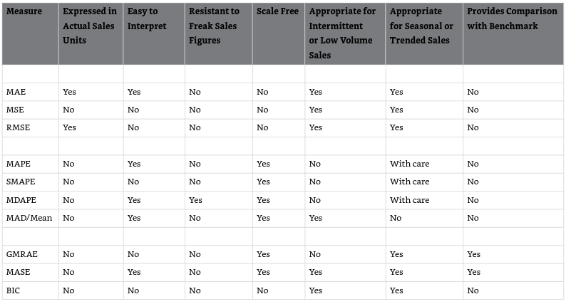
Comparing the different accuracy measures
Features of accuracy measures

Slide 35
Exception reporting

Slide 36
Exception reporting
Context
Forecasting sales for hundreds or thousands of products
Challenge
It takes time and effort to check the forecast accuracy of every product
Solution
Some software products have an exception reporting facility that alerts you when the forecasts for a particular product may need your attention
How
Setting up an acceptable range for error measures such as the MAE or MAPE
Alert if the current forecast is predicting an exceptionally large change from what has previously happened in the sales history

Slide 37
Forecast value-added analysis (FVA)

Slide 38
Forecast Value-Added analysis (FVA)
Mike Gilliland (SAS Institute) has extended the relative accuracy measures to a process called Forecast Value-Added analysis (FVA).
Idea
FVA not only enables you to see whether your forecasting method is more accurate than naïve forecasts, it allows you to examine every step in the forecasting process to see if it is contributing to improved accuracy
Example
Sales forecasting process in a company involves the following steps:
A computer produces a forecast automatically.
A sales manager uses her judgment to adjust the forecast based on market intelligence.
Senior managers then further adjust the forecast, if they think this is necessary.

Slide 39

Forecast Value-Added analysis (FVA)
The automatic computer forecasts are more accurate than the naïve forecasts they lower the MAPE by 11 percentage points. Hence the computer's FVA is +11%.
The sales manager's judgmental adjustments slightly improve the accuracy of the automatic forecasts
The adjustments of the senior manager raises the MAPE by 5% (FVA is -5%)
Some caveats
Different accuracy measures give different conclusions
Seasonal sales: use seasonal naïve as a benchmark
The difference in accuracy has not arisen by chance

Slide 40
Conclusions
The performance of a forecasting method should be assessed by comparing its forecasts to sales figures that it has not seen (i.e., the hold-out sample).
Be aware of the dangers of overfitting.
It's important to measure bias in forecasts as well as accuracy.
It is a good idea to use more than one measure to get a more “rounded” view of performance.
Take special care when measuring the performance of a method if sales are intermittent.
Forecast value-added (FVA) analysis can be useful in identifying which aspects of the forecasting process are damaging performance and which are improving it.

